Slide 1
Master Thesis Final Presentation
“Improving the Software Architecture Documentation Process of MediaWiki software”
14.09.2015, Ankitaa Bhowmick

Slide 2
Administrative Matters
Time:
February15th, 2015 to August 15th, 2015
Supervisor:
Prof. Dr. Florian Matthes
Advisor:
Klym Shumaiev

Slide 3

Agenda
Motivation
Research Questions
MediaWiki Software Process
Implementation Details
Evaluation & Conclusion

Slide 4


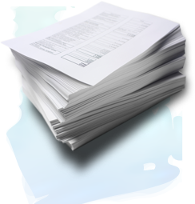

Motivation
Motivation
Research Questions
Mediawiki Software Process
Implementation Details
Evaluation & Conclusion
A good software architecture is the focal point of a good software
“To make this software maintainable and extendable, a state-of-the-art SA documentation process is required.” - The Software Sustainability Institute
“SA documentation needs to satisfy the needs of different stakeholders” - Documenting Software Architectures: Views and Beyond
SA document needs to be up-to-date with changes
“Software complexity grows with time and it becomes tedious to maintain the documentation” ^{[1]}
Lack of documentation is the downside of open source Software ^{[2]}

Slide 5

Motivation
Motivation
Research Questions
Mediawiki Software Process
Implementation Details
Evaluation & Conclusion
Drawbacks of the current Software Architecture Documentation (SAD) Process at Mediawiki
Outdated parts / missing parts of documentation
Some architecture documentation is available as a part of source code but not maintained on “mediawiki.org”
Limitations of open source software
  Irresponsibility to maintain documentation
  Informal processes
Requirement
An improved process to maintain software architecture documentation of MediaWiki.

Slide 6
Research Questions
Motivation
Research Questions
Mediawiki Software Process
Implementation Details
Evaluation & Conclusion
RQ1 : How software architecture documentation process can be improved for MediaWiki Software?
RQ2 : Which specific requirements of MediaWiki stakeholders should be met by documentation process for Software Architecture Documentation ?
RQ3 : What state-of-the-art architecture documentation processes are available in the industry that meet domain-specific requirements – e.g. Open Source Software ?
RQ4 : What are the metrics for evaluation of the software architecture documentation process and how can the quality of documentation process be assured ?

Slide 7

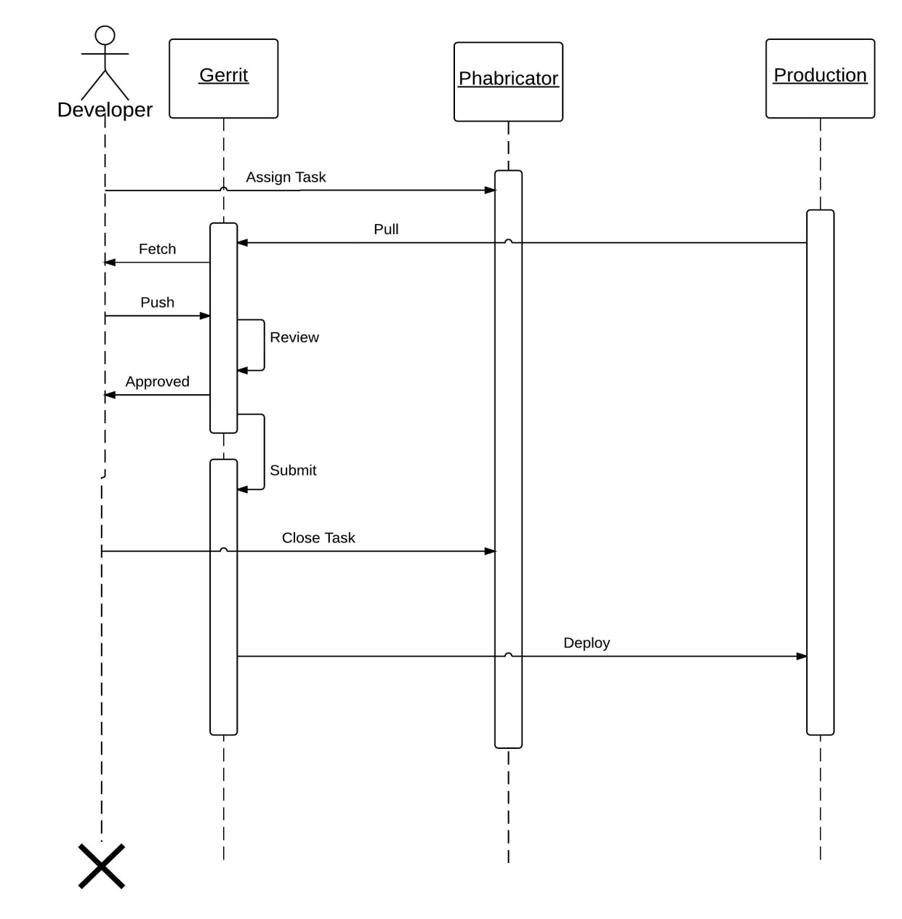
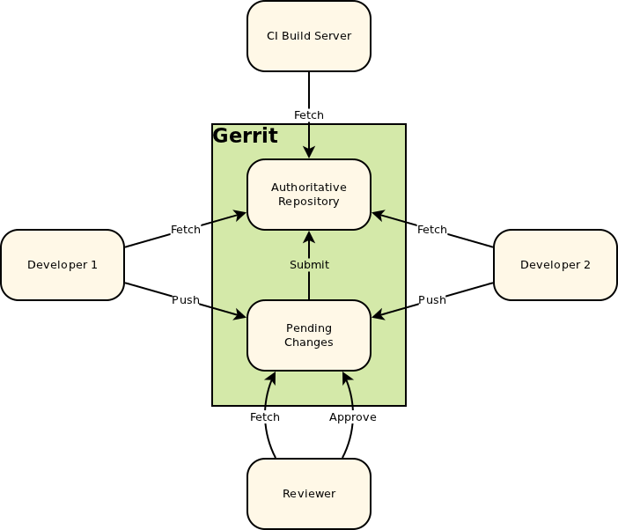

Mediawiki Software Process - Existing Schema
Motivation
Research Questions
Mediawiki Software Process
Implementation Details
Evaluation & Conclusion
1
2
3
Software process sequence diagram

Slide 8
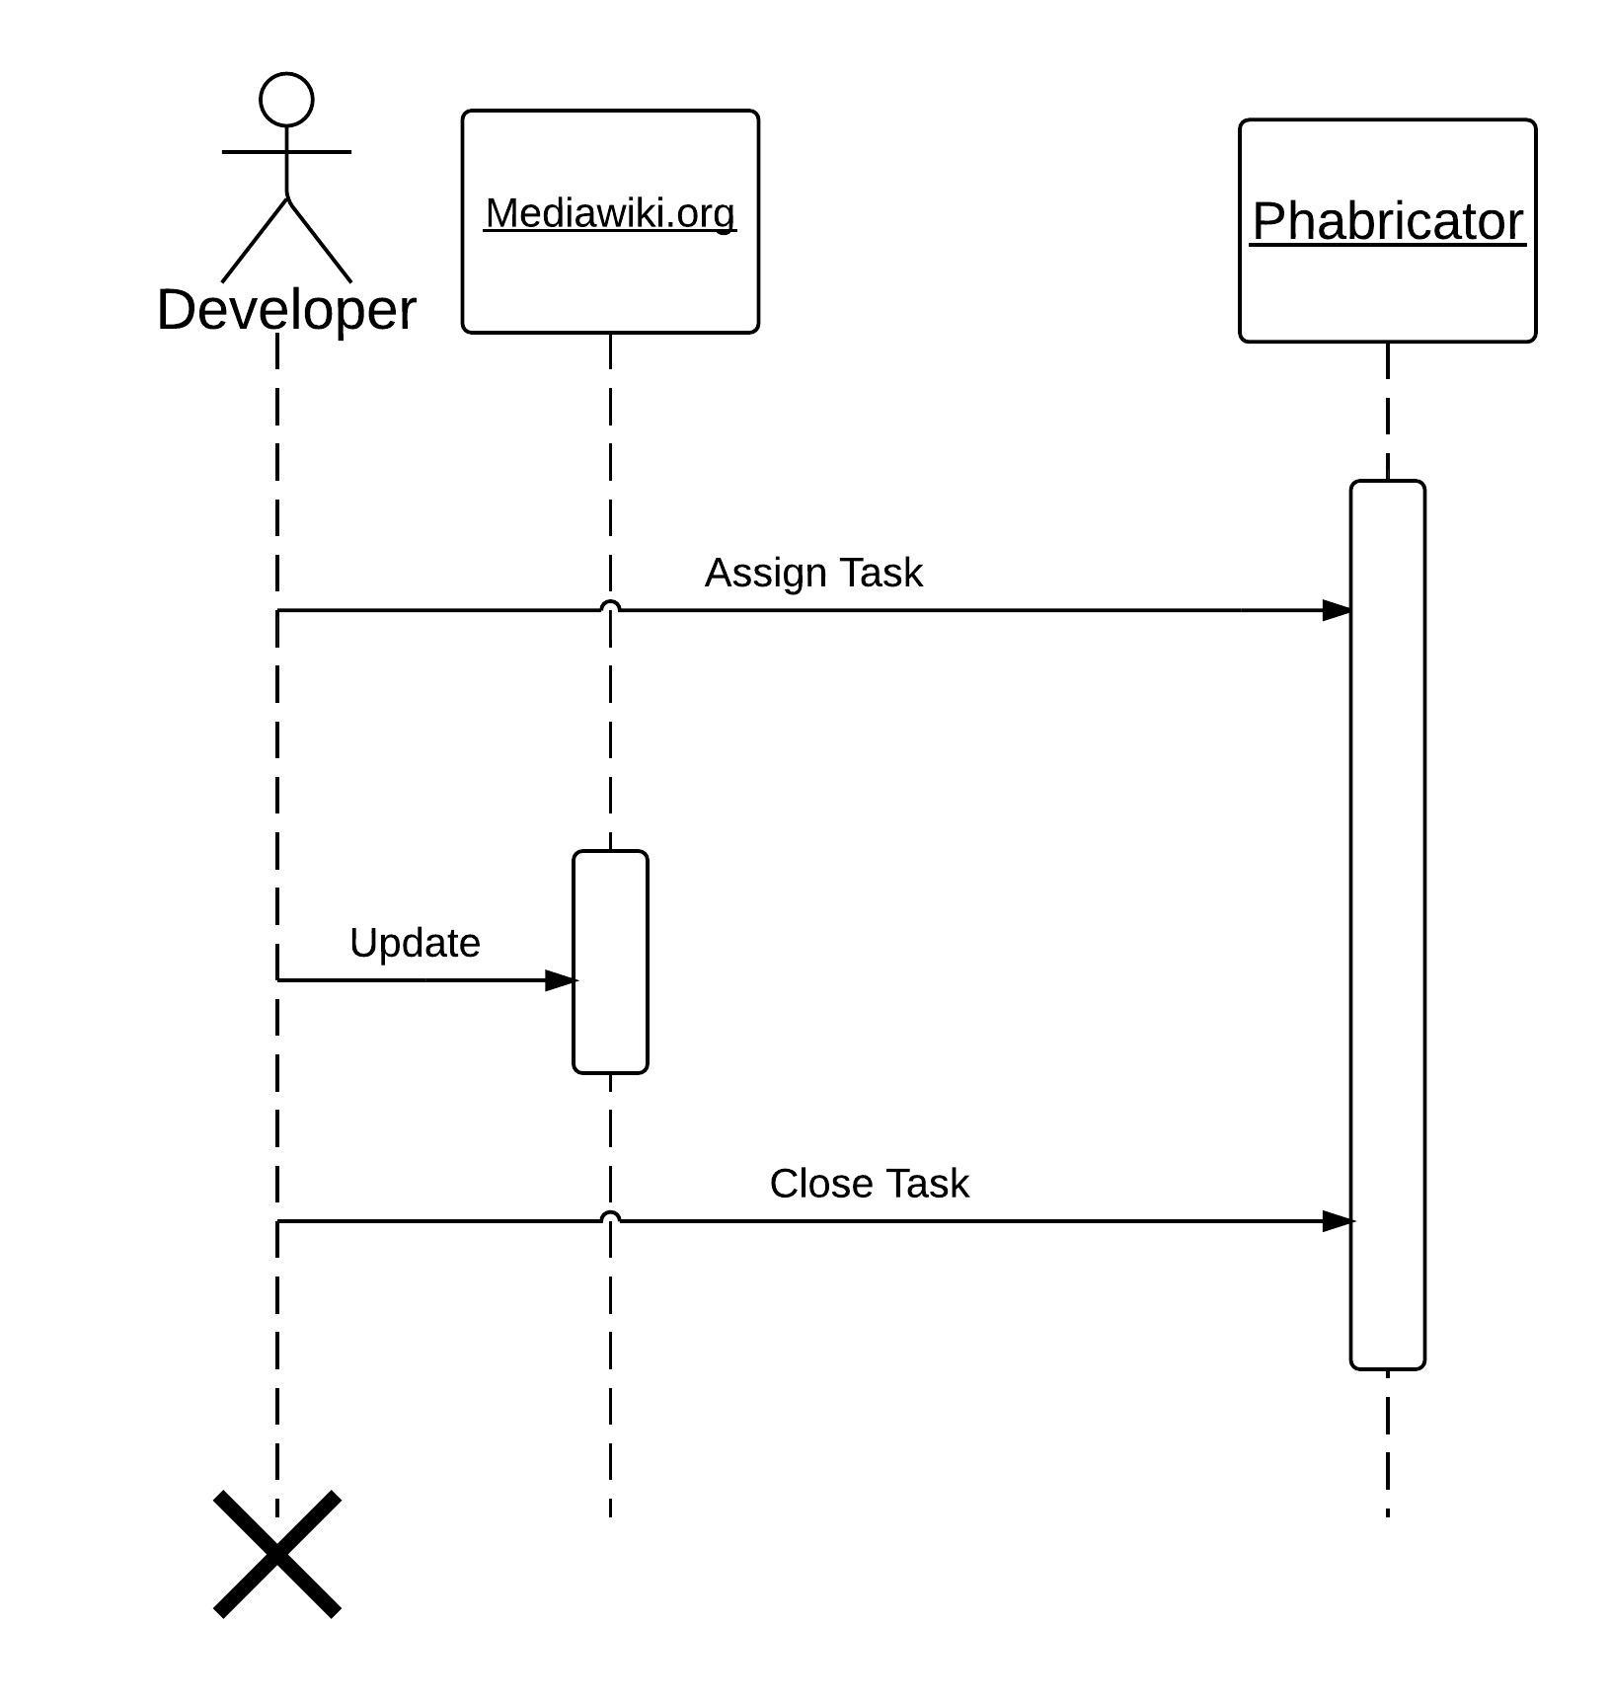
Mediawiki Software Process - Existing Schema
Motivation
Research Questions
Mediawiki Software Process
Implementation Details
Evaluation & Conclusion
1
2
3
Documentation process sequence diagram

Slide 9
Software Architecture Documentation Process – Existing Mediawiki Roles
Motivation
Research Questions
Mediawiki Software Process
Implementation Details
Evaluation & Conclusion
Code maintenance of an architectural component
Write documentation for Mediawiki software
Maintainers
Review the code changes before pushing to master
Documenter
Propose, Design and Rationalize the architectural changes
Reviewer
Implement the software architectural changes
Architect
Developer
Defined roles
Additional roles
The sphere of roles and responsibilities at Mediawiki
Expert role

Slide 10
Software Architecture Documentation Process - Stakeholder and Communtity Requirements
Motivation
Research Questions
Mediawiki Software Process
Implementation Details
Evaluation & Conclusion
Requirements
Interactive Sessions
Need for structured documentation
All documentation available on „mediawiki.org“
Detailed architectural component documentation as part of the MediaWiki source code.
Regular maintenance of documents.

Slide 11
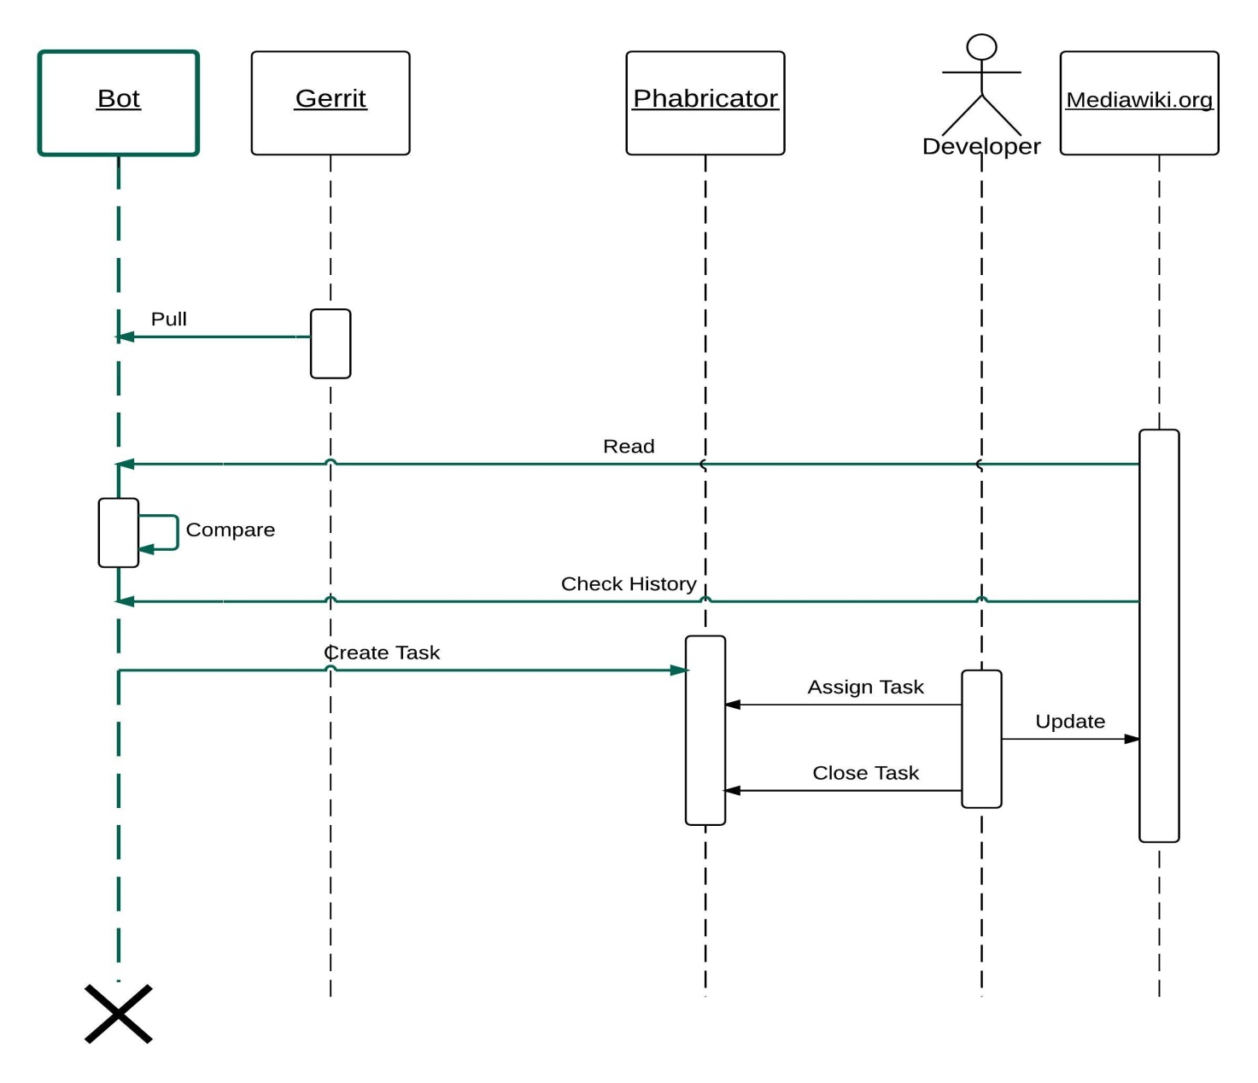


Implementation Details – Python BOT
Motivation
Research Questions
Mediawiki Software Process
Implementation Details
Evaluation & Conclusion
1
2
3
4
Improved Documentation Process sequence diagram

Slide 12
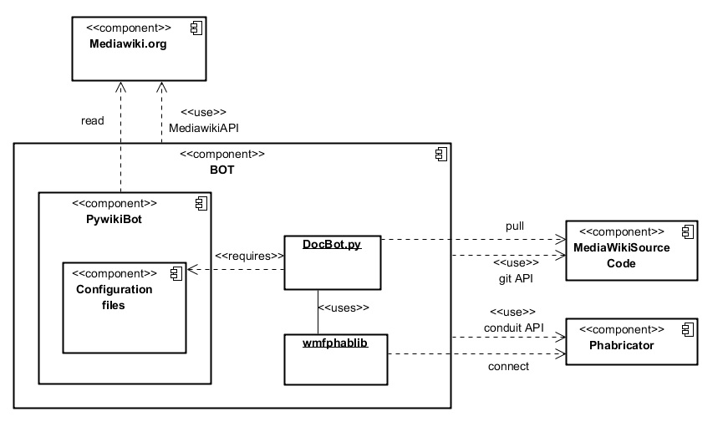
Implementation Details – BOT component diagram
Motivation
Research Questions
Mediawiki Software Process
Implementation Details
Evaluation & Conclusion
Component interactions in the implemented solution

Slide 13
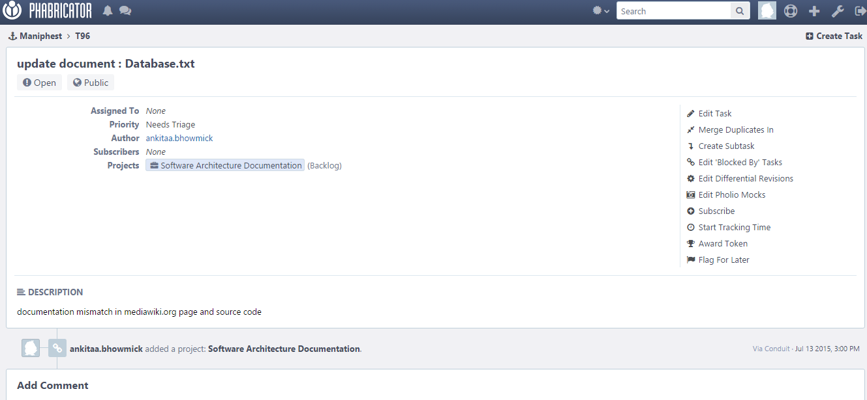
Implementation Details – Results
Motivation
Research Questions
Mediawiki Software Process
Implementation Details
Evaluation & Conclusion
Task is created on Phabricator by the BOT
Task subject : „update document : text_file_name“
Project : „Software Architecture Documentation“
Comments and discussions on the task
Docbot creates a documentation task on Phabricator

Slide 14
Research Questions
Motivation
Research Questions
Mediawiki Software Process
Implementation Details
Evaluation & Conclusion
RQ1 : How software architecture documentation process can be improved for MediaWiki Software?
RQ2 : Which specific requirements of MediaWiki stakeholders should be met by documentation process for Software Architecture Documentation ?
RQ3 : What state-of-the-art architecture documentation processes are available in the industry that meet domain-specific requirements – e.g. Open Source Software ?
RQ4 : What are the metrics for evaluation of the software architecture documentation process and how can the quality of documentation process be assured ?

Slide 15
Evaluation : SAD standards and processes
Motivation
Research Questions
Mediawiki Software Process
Implementation Details
Evaluation & Conclusion
Process-oriented Software engineering projects :
IEEE1471-2000 standard for software architecture documentation [3]
Open Source Software Communities :
The journal for “Systems and Software” provides an exploratory survey result :
over 61% of the OSS projects employ bug tracking tools to maintain their software and process [4]
70.4 % of the OSS projects use natural language with HTML as the main format for documenting software architecture [5].
Evaluation points for the implemented solution :
Process-oriented documentation maintenance is desirable for OSS
Wiki is a user-friendly and fitting medium for capturing documentation

Slide 16

Evaluation – Standard Metrics
Motivation
Research Questions
Mediawiki Software Process
Implementation Details
Evaluation & Conclusion
Metrics for improved process evaluation
Maintenance efforts and costs vs. capacity [8].
  Personnel
  Time
QualOSS standards for process evaluation [6].
  Review process
Process features also need to be evaluated [7].
  Architecture tracking
  Multiple user support
  Capture and reason
Around 20 architectural components identified for documentation
Each component has a maintainer
Some components already have “.txt ” file in source
The documents are a part of the source code
Final push from Gerrit mandates document review
Architectural changes are pushed along with corresponding documentation
All developers can access the code + document
Documents provide the rationale

Slide 17

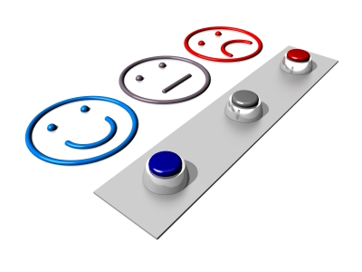
Evaluation – Stakeholder Satisfaction
Motivation
Research Questions
Mediawiki Software Process
Implementation Details
Evaluation & Conclusion
Evaluation of Improved documentation process via Review and Discussions
  Documentation quality assurance (feedback of MediaWiki architecture committee )
    Review is mandatory
    Maintenance of up-to-date documents on mediawiki.org is checked
  Process stability validation (feedback from MediaWiki developers)
    Well integrated with the existing software process.
  Ease of use / understandability ( Concerning new developers)
    Improved readability
    Access to all – free source
    Capture detailed architectural component description
  Acceptance in community (interviewing wiki community)
    Accepted !

Slide 18
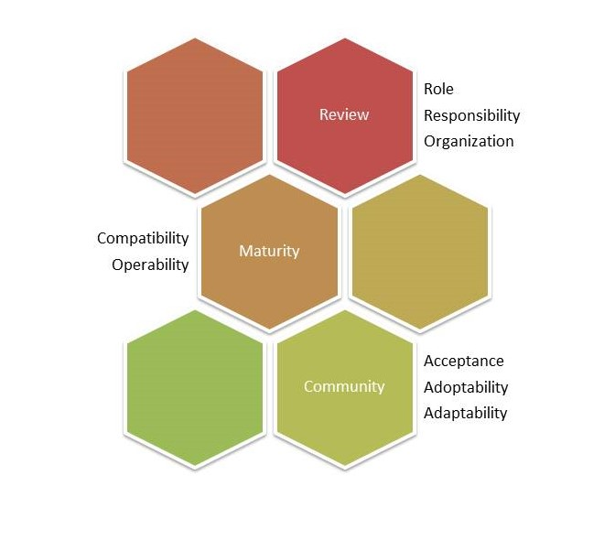
Conclusion – Process Improvement
Dimension of Software Architection Documentaion process and its improved features

Slide 19
Conclusion
This work’s implication is not just limited to Mediawiki but also reaches out far to find application for a maintainable documentation process in the Open Source Software community.
Further improvements to this basic solution is possible and a novel solution can be achieved for an improved software architecture documentation process.
Critical assessment has proved that the expectations of stakeholders have been met in terms of process requirements.
Process improvement (documentation process) is possible within the socio-technical limitations of Mediawiki community and within the broader scope of open source communities.

Slide 20
References
http://oss-watch.ac.uk/resources/archived/documentation
Fundamental issues with open source software development - Michelle Levesque
F. Bachmann, L. Bass, P. Clements, D. Garlan, J. Ivers, M. Little, P. Merson, R. Nord, and J. Stafford. Documenting Software Architectures: Views and Beyond
L. Zhao and S. Elbaum. “Quality assurance under the open source development model.” In: Journal of Systems and Software
W. Ding, P. Liang, A. Tang, H. V. Vliet, and M. Shahin. “How Do Open Source Communities Document Software Architecture: An Exploratory Survey.”
The QualOSS Open Source Assessment Model Measuring the Performance of Open Source Communities - Martín Soto and Marcus Ciolkowski
Software Process: A Roadmap - Alfonso Fuggeffa
A systematic review of software architecture visualization techniques – Babar et.al

Slide 21


Slide 22
Backup Slides

Slide 23
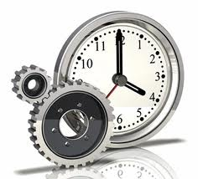

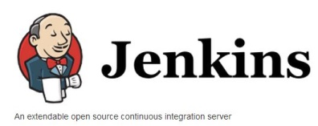
Mediawiki Software Process - Existing Schema
Motivation
Research Questions
Mediawiki Software Process
Implementation Details
Evaluation & Conclusion
Code commits
Deploy
P
R
O
D
U
C
T
I
O
N
Continuous Integration
Developer
Documentation
Task Owner
Task Creation and Tracking

Slide 24

Mediawiki SAD process - Proposed Solution
Motivation
Research Questions
Mediawiki Software Process
Implementation Details
Evaluation & Conclusion
Deploy
Code commits
P
R
O
D
U
C
T
I
O
N
Continuous Integration
Developer
Documentation
Pull latest source code
Compare Mediawiki.org pages / Check History
Task Creation and Tracking
Create documentation task if docs are not consistent
Task Owner

